Slide 1
IDSB and SDB Meetings with AceInfo/Dovel
March 2020

Slide 2
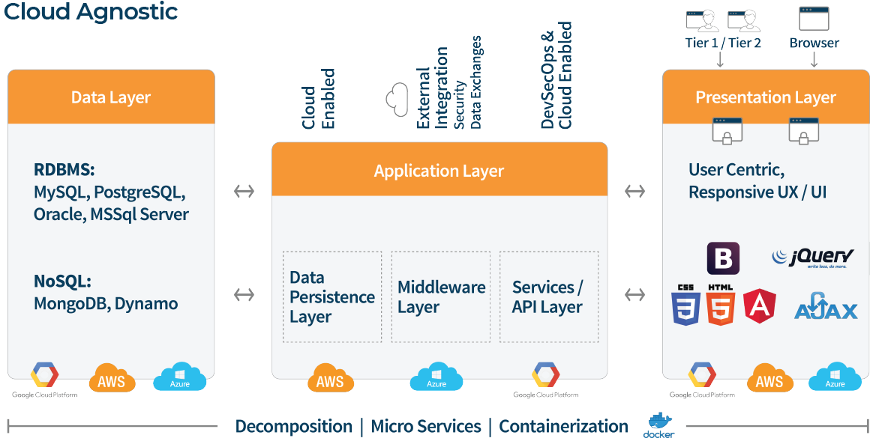
Enterprise digital Modernization and systems integration cloud native applications

Slide 3
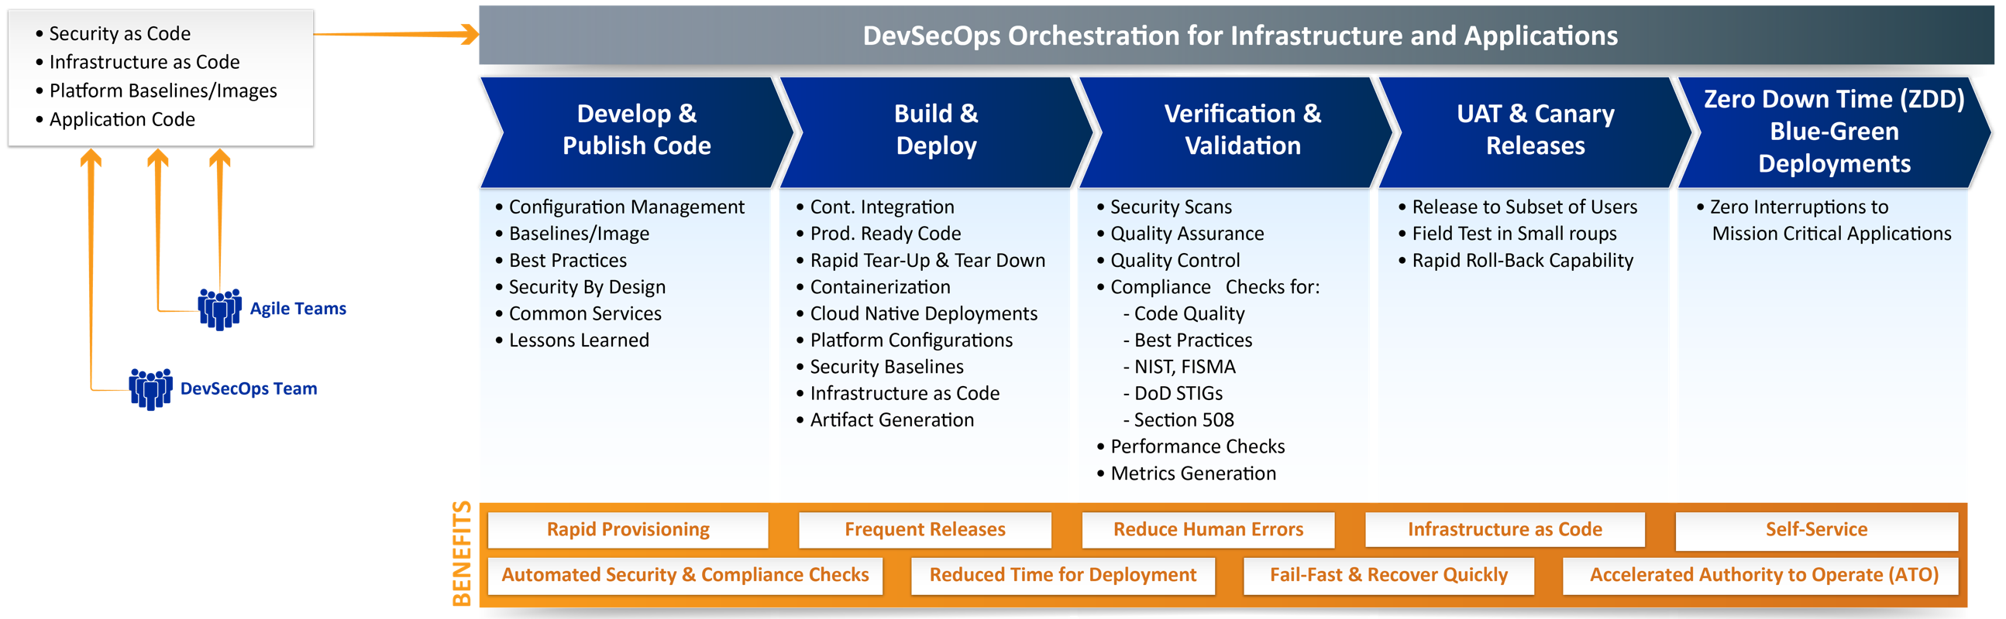
Enterprise digital Modernization and systems integration continuous Integration & Continuous Delivery/Deployments

Slide 4
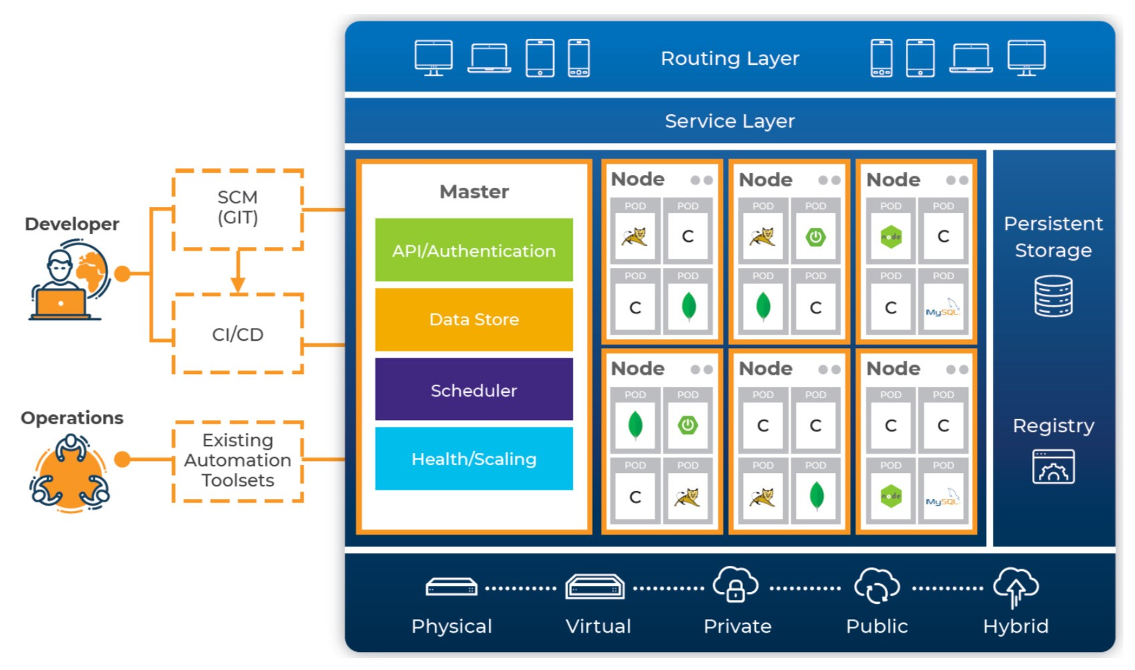
Enterprise digital Modernization and systems integration
Container based INTELLIGENT PLATFORMS AND TURNKEY SOLUTIONS AS A SERVICE
Turnkey Solutions
  Cloud Adoption
  Immutability
  Secruity / ATO
  Scale and Failure
  AIOPs
  Self-Configure
  Self-Heal
  Self-Optimize
  Self-Protect
Turnkey Platformsernetes
  Openshift
  Redhat Openshift
  Google Cloud (GKE)
  AWS (ECS, EKS)
  AZURE (CS, KS)

Slide 5
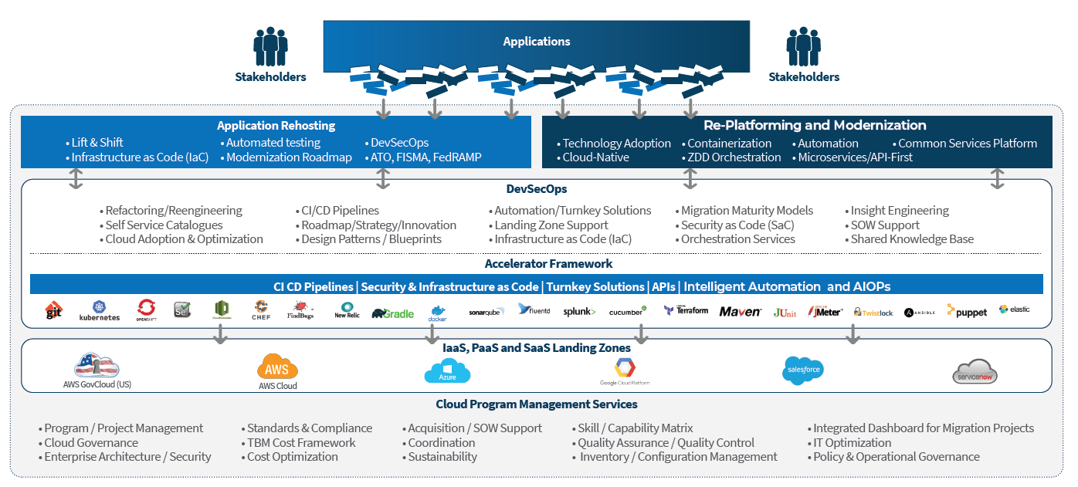
Cloud adoption and Infrastructure Optimization
Accelerate hybrid-cloud deployments while maximizing innovation
Data Center Consolidation and IT Optimization through Private, Hybrid and Multi-Cloud implementations
An Accelerator Framework for cloud adoption, comprising repeatable processes, architecture blueprints, turnkey services and landing zones with disaster recovery and failover
Single pane of glass for cloud administration, governance, billing and operational intelligence
Infrastructure and Security as Code along with automated Security and Compliance (Authority To Operate)
Intelligent automation and orchestration with self-healing capabilities (DevSecOps / AIOps)

Slide 6
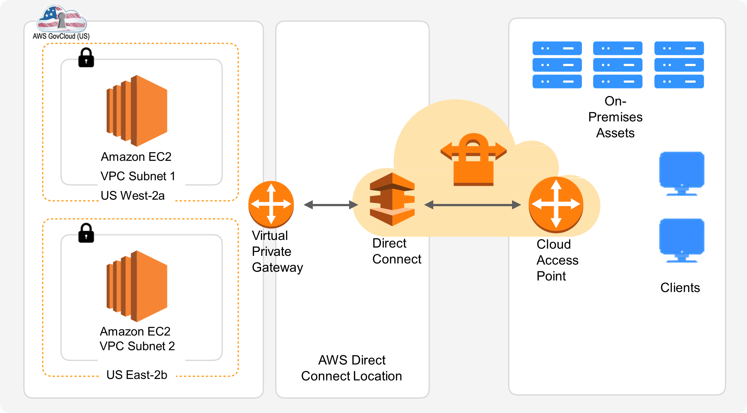
Cloud adoption and Infrastructure Optimization
Disaster recovery in AWS Cloud
AWS Global Infrastructure
  2 US GovCloud Regions (US East and West) with 6 Availability Zones
  21 Geographic Regions with 66 Availability Zones
Infrastructure as Code
Security as Code Automation as Code

Slide 7
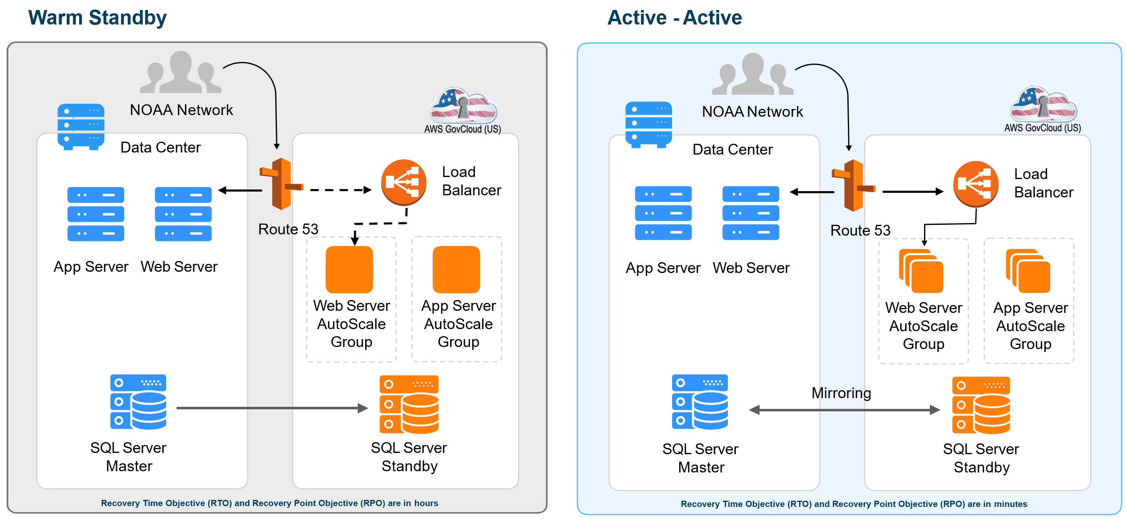
Cloud adoption and Infrastructure Optimization
Disaster recovery in AWS Cloud - Approaches

Slide 8
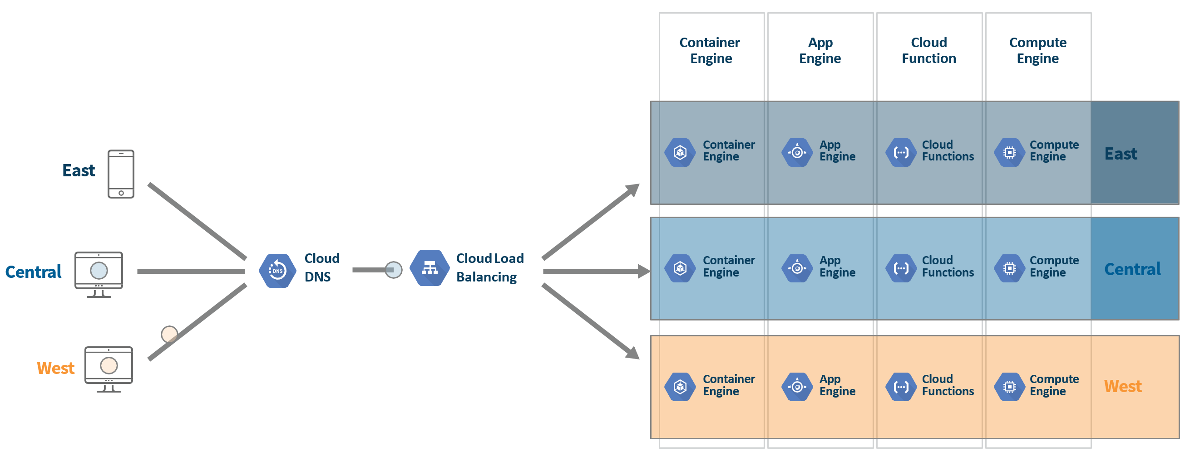
Cloud adoption and Infrastructure Optimization
Multi Region Failover & High Availability (Kubernetes Based Orchestration)

